Slide 1
Information Extraction
Shobeir Fakhraei
University of Southern California
Slides based on material provided by Andrew McCallum, William Cohen, Matt Michelson, Xiang Ren, and others.

Slide 2
Where are we?
Information Extraction
Semi-structured: Web, HTML
Unstructured: Text, Adds, Tweets, …
Entity Linkage, Data Cleaning, Normalization
Logical Data Integration
Mediators, Query Rewriting
Warehouse, Logical Data Exchange
Automatic Source Modeling/Learning Schema Mappings
Semantic Web
RDF, SPARQL, OWL, Linked Data
Advanced Topics
Geospatial Data Integration, Knowledge Graphs

Slide 3
Outline
What is information extraction
Information extraction landscape
Inner workings of some techniques

Slide 4
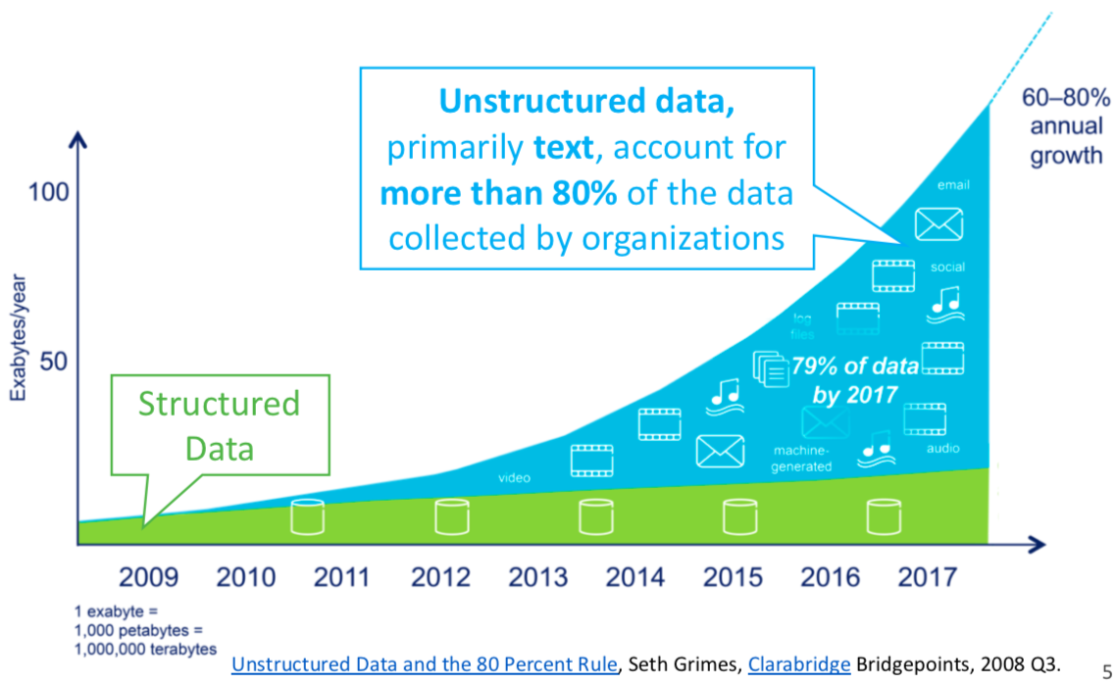
Growth of Unstructured Text Data

Slide 5
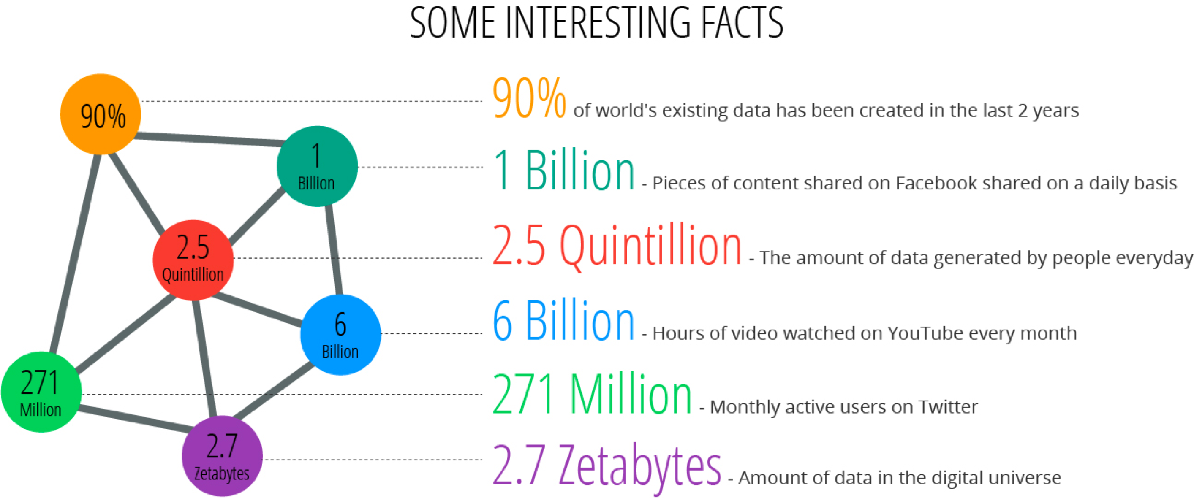

The Era of Big Data
4

Slide 6
What is Information Extraction
As a task:
Filling slots in a database from sub-segments of text.
October 14, 2002, 4:00 a.m. PT
For years, Microsoft Corporation CEO Bill Gates railed against the economic philosophy of open-source software with Orwellian fervor, denouncing its communal licensing as a "cancer" that stifled technological innovation.
Today, Microsoft claims to "love" the open-source concept, by which software code is made public to encourage improvement and development by outside programmers. Gates himself says Microsoft will gladly disclose its crown jewels--the coveted code behind the Windows operating system--to select customers.
"We can be open source. We love the concept of shared source," said Bill Veghte, a Microsoft VP. "That's a super-important shift for us in terms of code access.“
Richard Stallman, founder of the Free Software Foundation, countered saying…
NAME TITLE ORGANIZATION
Notes:
What is IE. As a task it is…
Starting with some text… and a empty data base with a defined ontology of fields and records,
Use the information in the text to fill the database.

Slide 7
What is Information Extraction
As a task:
Filling slots in a database from sub-segments of text.
October 14, 2002, 4:00 a.m. PT
For years, Microsoft Corporation CEO Bill Gates railed against the economic philosophy of open-source software with Orwellian fervor, denouncing its communal licensing as a "cancer" that stifled technological innovation.
Today, Microsoft claims to "love" the open-source concept, by which software code is made public to encourage improvement and development by outside programmers. Gates himself says Microsoft will gladly disclose its crown jewels--the coveted code behind the Windows operating system--to select customers.
"We can be open source. We love the concept of shared source," said Bill Veghte, a Microsoft VP. "That's a super-important shift for us in terms of code access.“
Richard Stallman, founder of the Free Software Foundation, countered saying…
IE
NAME TITLE ORGANIZATION
Bill Gates CEO Microsoft
Bill Veghte VP Microsoft
Richard Stallman founder Free Soft..

Slide 8
What is Information Extraction
As a family of techniques:
Information Extraction =
segmentation + classification + association + clustering
October 14, 2002, 4:00 a.m. PT
For years, Microsoft Corporation CEO Bill Gates railed against the economic philosophy of open-source software with Orwellian fervor, denouncing its communal licensing as a "cancer" that stifled technological innovation.
Today, Microsoft claims to "love" the open-source concept, by which software code is made public to encourage improvement and development by outside programmers. Gates himself says Microsoft will gladly disclose its crown jewels--the coveted code behind the Windows operating system--to select customers.
"We can be open source. We love the concept of shared source," said Bill Veghte, a Microsoft VP. "That's a super-important shift for us in terms of code access.“
Richard Stallman, founder of the Free Software Foundation, countered saying…
Microsoft Corporation
CEO
Bill Gates
Microsoft
Gates
Microsoft
Bill Veghte
Microsoft
VP
Richard Stallman
founder
Free Software Foundation
aka
“named entity extraction”
Notes:
As a family of techniques, is consists of
Segmentation to find the beginning and ending boundaries of the text snippets that will go in the DB.
Classification…

Slide 9
What is Information Extraction
As a family of techniques:
Information Extraction =
segmentation + classification + association + clustering
October 14, 2002, 4:00 a.m. PT
For years, Microsoft Corporation CEO Bill Gates railed against the economic philosophy of open-source software with Orwellian fervor, denouncing its communal licensing as a "cancer" that stifled technological innovation.
Today, Microsoft claims to "love" the open-source concept, by which software code is made public to encourage improvement and development by outside programmers. Gates himself says Microsoft will gladly disclose its crown jewels--the coveted code behind the Windows operating system--to select customers.
"We can be open source. We love the concept of shared source," said Bill Veghte, a Microsoft VP. "That's a super-important shift for us in terms of code access.“
Richard Stallman, founder of the Free Software Foundation, countered saying…
Microsoft Corporation
CEO
Bill Gates
Microsoft
Gates
Microsoft
Bill Veghte
Microsoft
VP
Richard Stallman
founder
Free Software Foundation

Slide 10
What is Information Extraction
As a family of techniques:
Information Extraction =
segmentation + classification + association + clustering
October 14, 2002, 4:00 a.m. PT
For years, Microsoft Corporation CEO Bill Gates railed against the economic philosophy of open-source software with Orwellian fervor, denouncing its communal licensing as a "cancer" that stifled technological innovation.
Today, Microsoft claims to "love" the open-source concept, by which software code is made public to encourage improvement and development by outside programmers. Gates himself says Microsoft will gladly disclose its crown jewels--the coveted code behind the Windows operating system--to select customers.
"We can be open source. We love the concept of shared source," said Bill Veghte, a Microsoft VP. "That's a super-important shift for us in terms of code access.“
Richard Stallman, founder of the Free Software Foundation, countered saying…
Microsoft Corporation
CEO
Bill Gates
Microsoft
Gates
Microsoft
Bill Veghte
Microsoft
VP
Richard Stallman
founder
Free Software Foundation

Slide 11
What is Information Extraction
As a family of techniques:
Information Extraction =
segmentation + classification + association + clustering
October 14, 2002, 4:00 a.m. PT
For years, Microsoft Corporation CEO Bill Gates railed against the economic philosophy of open-source software with Orwellian fervor, denouncing its communal licensing as a "cancer" that stifled technological innovation.
Today, Microsoft claims to "love" the open-source concept, by which software code is made public to encourage improvement and development by outside programmers. Gates himself says Microsoft will gladly disclose its crown jewels--the coveted code behind the Windows operating system--to select customers.
"We can be open source. We love the concept of shared source," said Bill Veghte, a Microsoft VP. "That's a super-important shift for us in terms of code access.“
Richard Stallman, founder of the Free Software Foundation, countered saying…
*
Microsoft Corporation
CEO
Bill Gates
Microsoft
Gates
Microsoft
Bill Veghte
Microsoft
VP
Richard Stallman
founder
Free Software Foundation
*
*
NAME
TITLE ORGANIZATION
Bill Gates
CEO
Microsoft
*
Bill
Veghte
VP
Microsoft
Richard
Stallman
founder
Free Soft..

Slide 12
IE in Context
Create ontology
Spider
Filter by relevance
IE
Segment
Classify
Associate
Cluster
Database
Load DB
Document collection
Train extraction models
Query,
Search
Label training data
Data mine

Slide 13
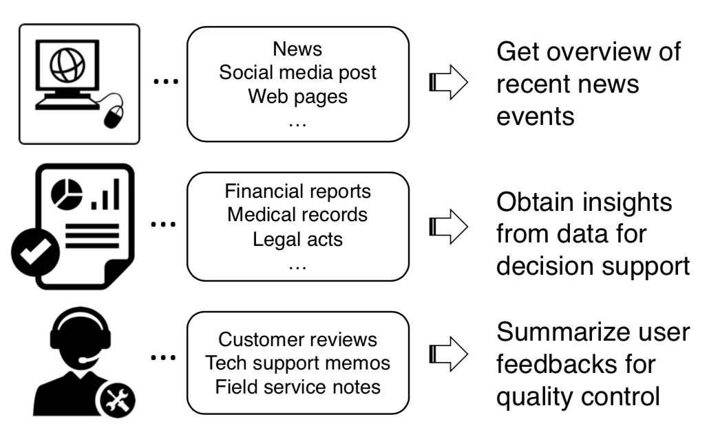
Applications: Enterprise
Notes:
Poor Doug Lenat, creating Cyc. I was there at ICML in 1991… Now 11 years later.

Slide 14



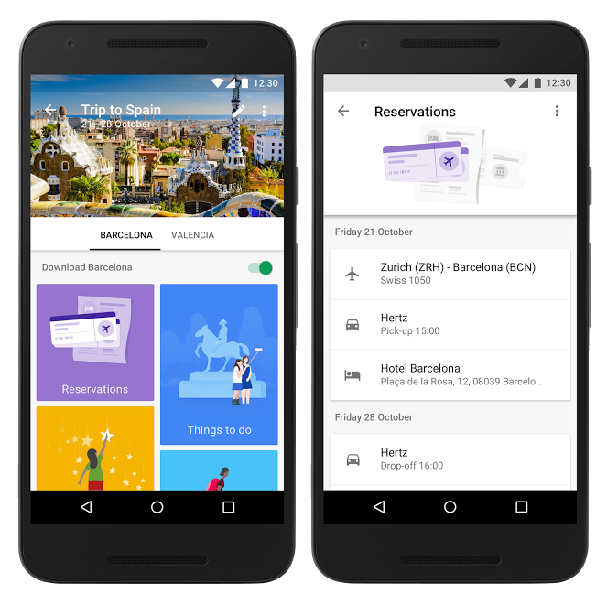
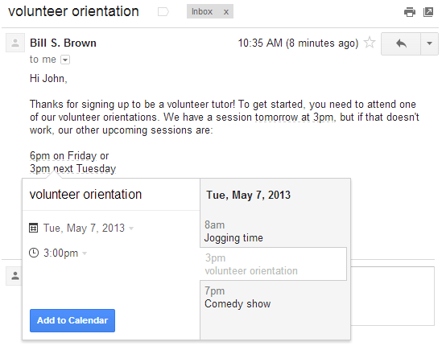
Applications: PIM
PIM: Personal Information Management
Organize personal data e.g., documents, emails, contacts.

Slide 15
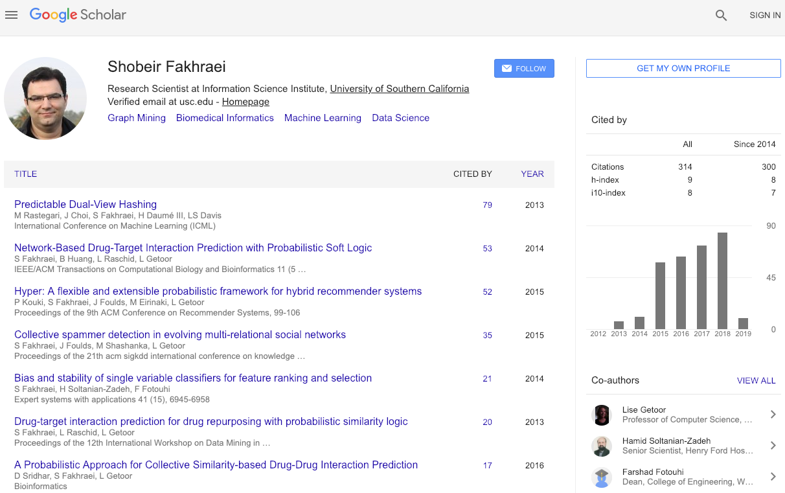

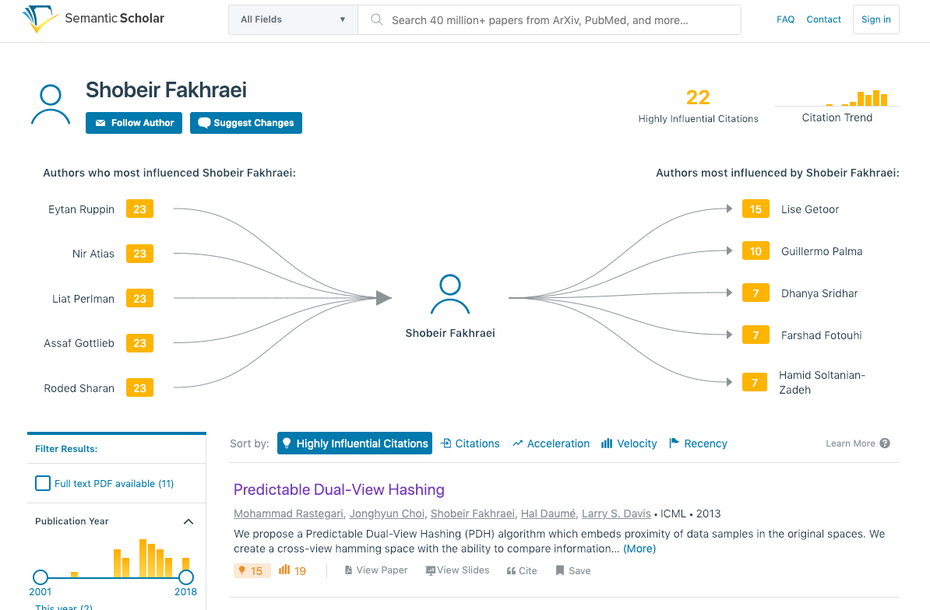
Applications: Scientific
Build large knowledge base and reason with it
Inspires new advances in machine learning
Notes:
Poor Doug Lenat, creating Cyc. I was there at ICML in 1991… Now 11 years later.

Slide 16
IE History
Pre-Web
Mostly news articles
De Jong’s FRUMP [1982]
Hand-built system to fill Schank-style “scripts” from news wire
Message Understanding Conference (MUC) DARPA [’87-’95], TIPSTER [’92-’96]
Most early work dominated by hand-built models
E.g. SRI’s FASTUS, hand-built FSMs.
But by 1990’s, some machine learning: Lehnert, Cardie, Grishman and then HMMs: Elkan [Leek ’97], BBN [Bikel et al ’98]
Web
AAAI ‘94 Spring Symposium on“Software Agents”
Much discussion of ML applied to Web. Maes, Mitchell, Etzioni.
Tom Mitchell’s WebKB, ‘96
Build KB’s from the Web.
Wrapper Induction
Initially hand-build, then ML: [Soderland ’96], [Kushmeric ’97],…
Citeseer; Cora; FlipDog; contEd courses, corpInfo,...
Notes:
ML… although this is an area where ML has not yet trounced the hand-built systems. In some of the latest evaluations, hand-built shared 1st place with a ML.
Now many companies making a business from IE (from the Web): WasBang, Inxight, Intelliseek, ClearForest.

Slide 17
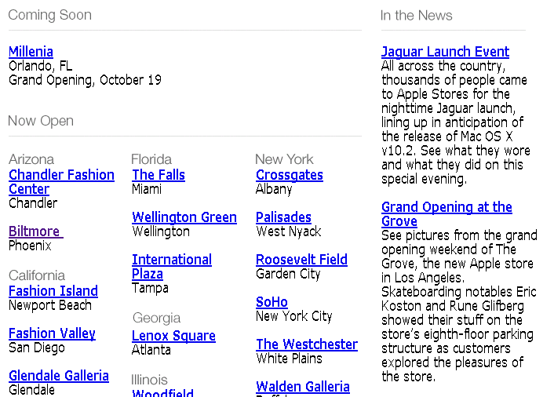
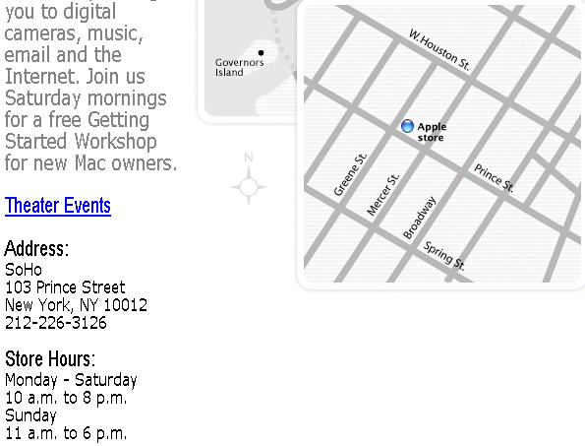
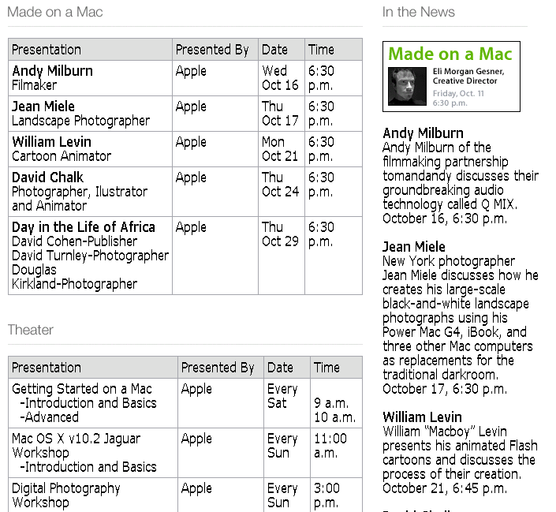
What makes IE from the Web Different?
Less grammar, but more formatting & linking
Newswire
Web
www.apple.com/retail
Apple to Open Its First Retail Store
in New York City
MACWORLD EXPO, NEW YORK--July 17, 2002--Apple's first retail store in New York City will open in Manhattan's SoHo district on Thursday, July 18 at 8:00 a.m. EDT. The SoHo store will be Apple's largest retail store to date and is a stunning example of Apple's commitment to offering customers the world's best computer shopping experience.
"Fourteen months after opening our first retail store, our 31 stores are attracting over 100,000 visitors each week," said Steve Jobs, Apple's CEO. "We hope our SoHo store will surprise and delight both Mac and PC users who want to see everything the Mac can do to enhance their digital lifestyles."
www.apple.com/retail/soho
www.apple.com/retail/soho/theatre.html
The directory structure, link structure, formatting & layout of the Web is its own new grammar.
Notes:
Traditionally, IE was done mostly on newswire: flowing, grammatical sentences with little or no formatting information.
The Web is different: less grammar, more ungrammatical little snippets, but rich formatting and layout information.
This directory structure…
So lets consider the dimensions of the IE landscape.
First some ways in which the problem space varies:

Slide 18
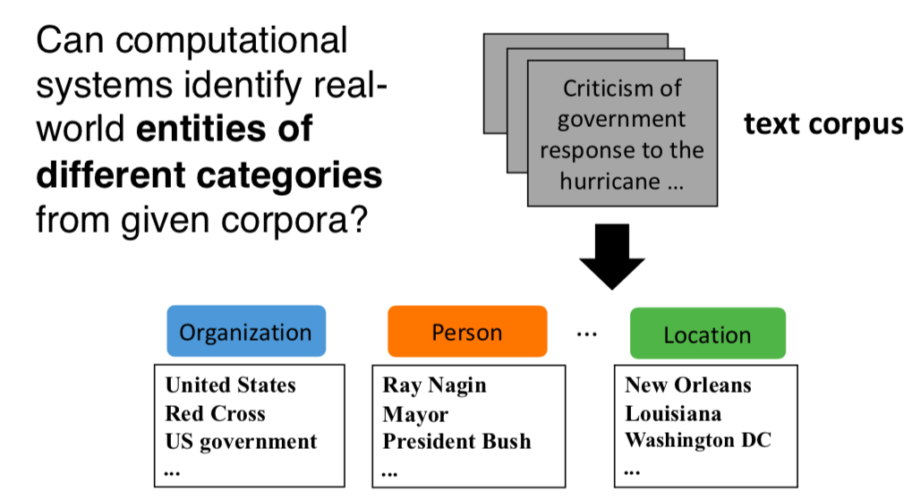
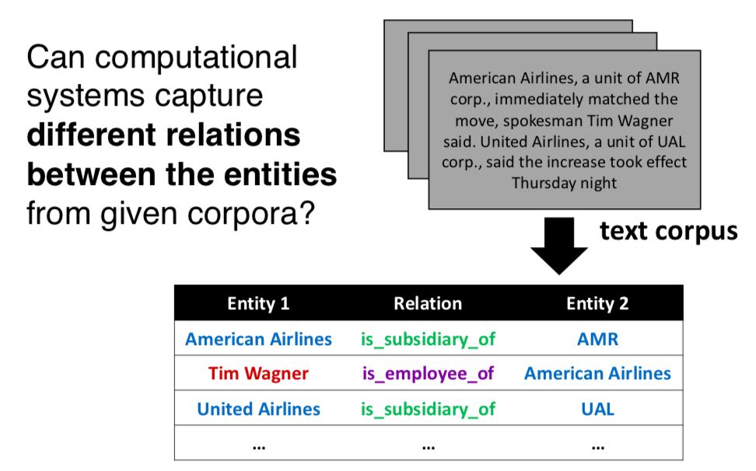
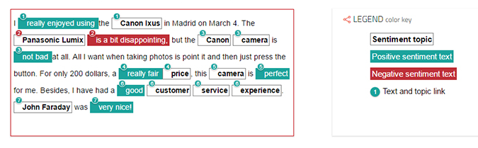
Landscape of IE Tasks (1): Types of Extractions
Named Entity Recognition
Relationship Extraction
Adjective Extractions -> Sentiment Analysis

Slide 19
Landscape of IE Tasks (2): Granularity of Extraction
Record or Sentence. e.g.
Address
Classified Ad
Citation
Paragraph and Document. e.g.,
News Article
Emails

Slide 20
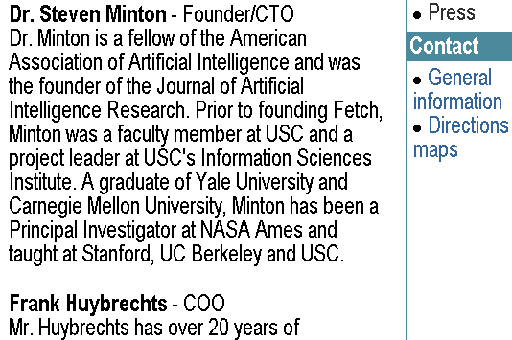
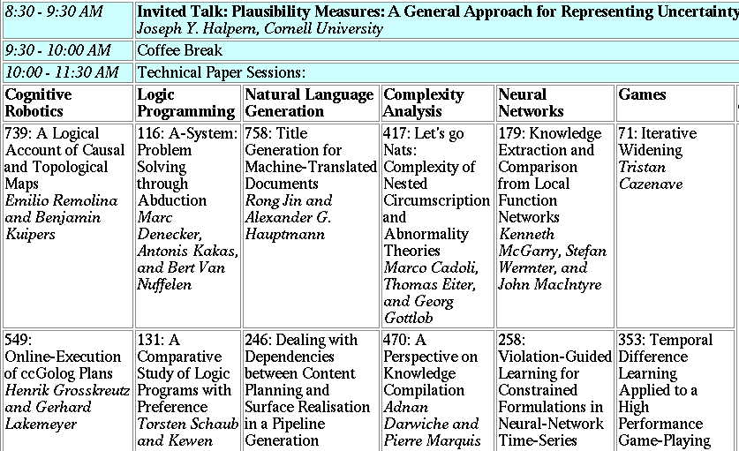
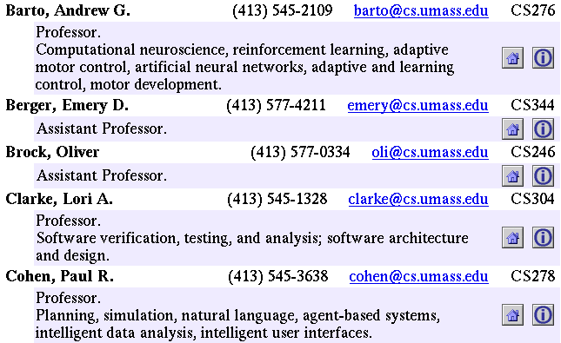
Landscape of IE Tasks (3): Degree of Structure
Text paragraphs
without formatting
Grammatical sentences and some formatting & links
Astro Teller is the CEO and co-founder of BodyMedia. Astro holds a Ph.D. in Artificial Intelligence from Carnegie Mellon University, where he was inducted as a national Hertz fellow. His M.S. in symbolic and heuristic computation and B.S. in computer science are from Stanford University. His work in science, literature and business has appeared in international media from the New York Times to CNN to NPR.
Non-grammatical snippets, rich formatting & links
Tables
Notes:
Different families of features may be more or less useful in different data sets.

Slide 21
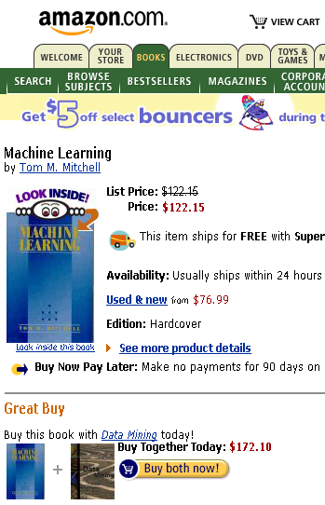


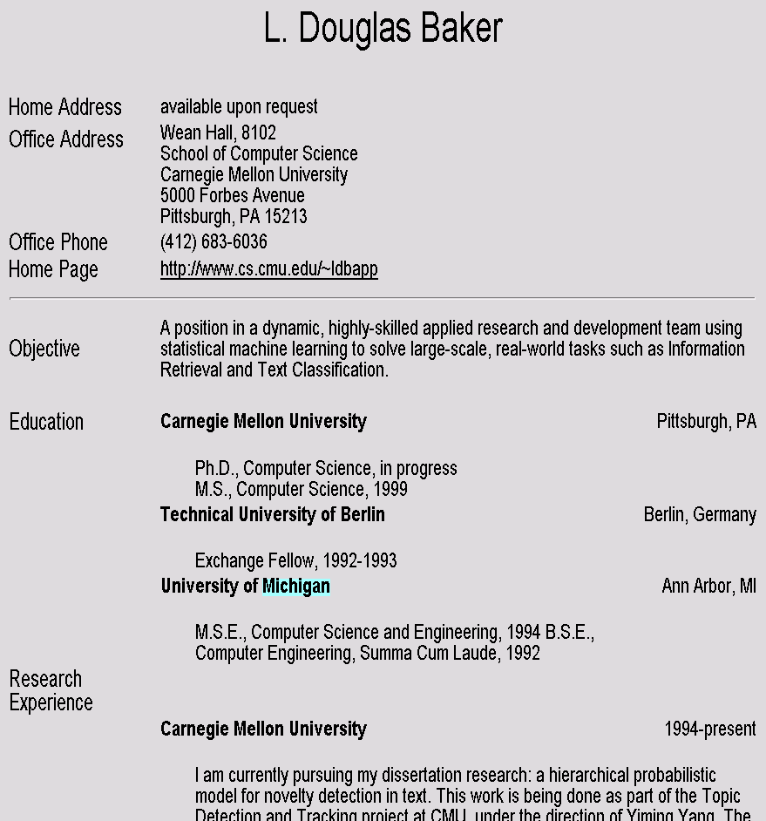
Landscape of IE Tasks (4): Heterogeneity of Source
Web site specific
Genre specific
Wide, non-specific
Formatting
Layout
Language
Amazon.com Book Pages
Resumes
University Names
Notes:
If you were going to use formatting to do extraction, how often (with what granularity) would you have to re-train your models?

Slide 22
Landscape of IE Tasks (5): Pattern Complexity
Closed set
Regular set
U.S. states
U.S. phone numbers
He was born in Alabama…
Phone: (413) 545-1323
The big Wyoming sky…
The CALD main office can be reached at 412-268-1299
Complex pattern
Ambiguous patterns, needing context and many sources of evidence
U.S. postal addresses
University of Arkansas
P.O. Box 140
Hope, AR 71802
Person names
…was among the six houses sold by Hope Feldman that year.
Headquarters:
1128 Main Street, 4th Floor
Cincinnati, Ohio 45210
Pawel Opalinski, Software Engineer at WhizBang Labs.
Notes:
How complicated a modeling technique will you have to use?

Slide 23
Landscape of IE Tasks (6): Pattern Combinations
Jack Welch will retire as CEO of General Electric tomorrow. The top role at the Connecticut company will be filled by Jeffrey Immelt.
Single entity
Binary relationship
N-ary record
Person: Jack Welch
Relation: Person-Title
Person: Jack Welch
Title: CEO
Relation: Succession
Company: General Electric
Title: CEO
Out: Jack Welsh
In: Jeffrey Immelt
Person: Jeffrey Immelt
Location: Connecticut
Relation: Company-Location
Company: General Electric
Location: Connecticut
Notes:
How many components of the output of your system? Single entity…
It is more difficult to get high accuracy on the right than on the left, because each consituent has to be right, and errors compound. 90%^5=60%

Slide 24
IE Technique Examples
Classify Pre-segmented Candidates
Lexicons
Sliding Window
Abraham Lincoln was born in Kentucky.
Abraham Lincoln was born in Kentucky.
Abraham Lincoln was born in Kentucky.
member?
Classifier
Alabama
Alaska
…
Wisconsin
Wyoming
Classifier
which class?
which class?
Try alternate window sizes:
Boundary Models
Finite State Machines
Context Free Grammars
Abraham Lincoln was born in Kentucky.
Abraham Lincoln was born in Kentucky.
Abraham Lincoln was born in Kentucky.
BEGIN
Most likely state sequence?
NNP
NNP
V
V
P
NP
Classifier
Most likely parse?
PP
which class?
VP
NP
VP
BEGIN
END
BEGIN
END
S
…and beyond
Any of these models can be used to capture words, formatting or both.

Slide 25
State of the Art Performance
Named entity recognition
Person, Location, Organization, …
F1 in high 80’s or low- to mid-90’s
Binary relation extraction
Contained-in (Location1, Location2) Member-of (Person1, Organization1)
F1 in 60’s or 70’s or 80’s
Wrapper induction
Extremely accurate performance obtainable
Human effort (~30min) required on each site

Slide 26
Named Entity Recognition

Slide 27
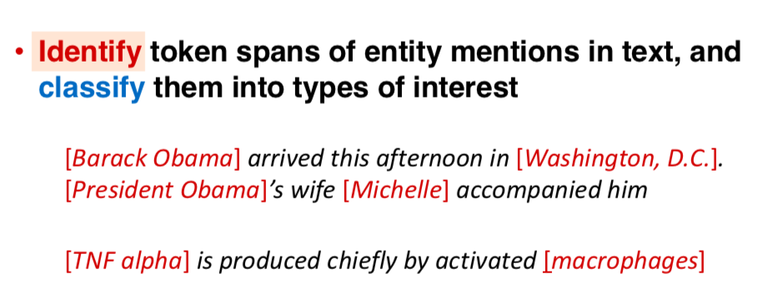
Entity Recognition (and Typing)

Slide 28
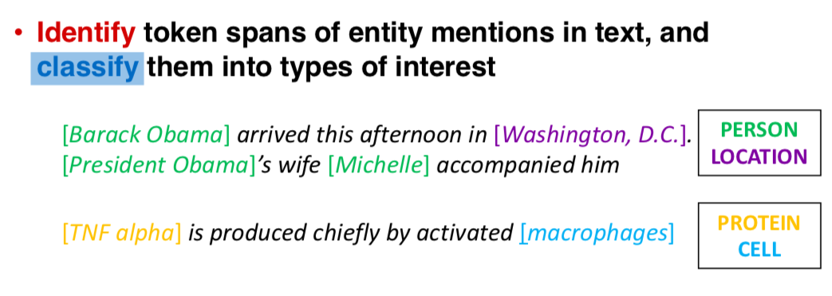
Entity Recognition (and Typing)

Slide 29
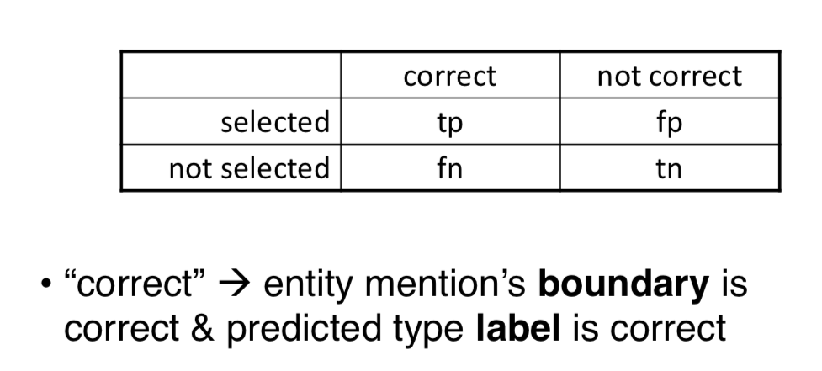
Evaluation: Contingency table

Slide 30
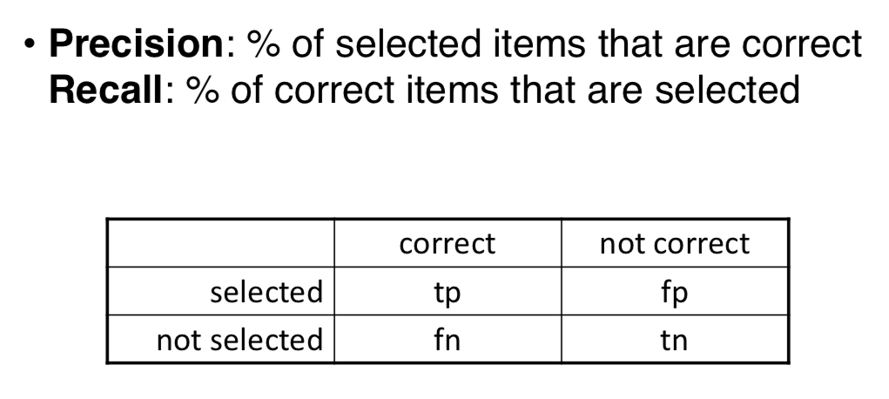
Evaluation: Precision / Recall

Slide 31
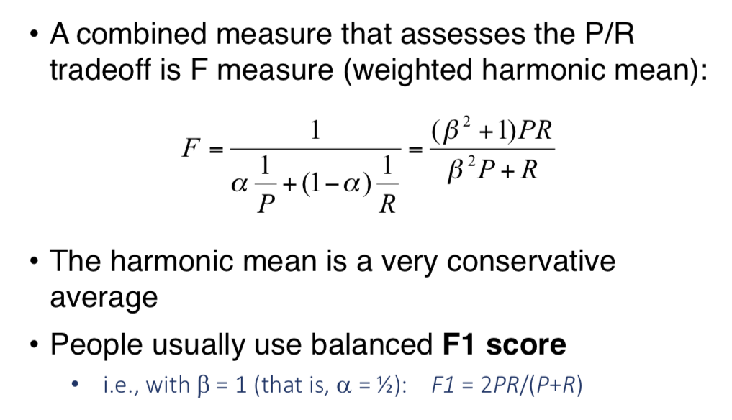
F1 Score

Slide 32
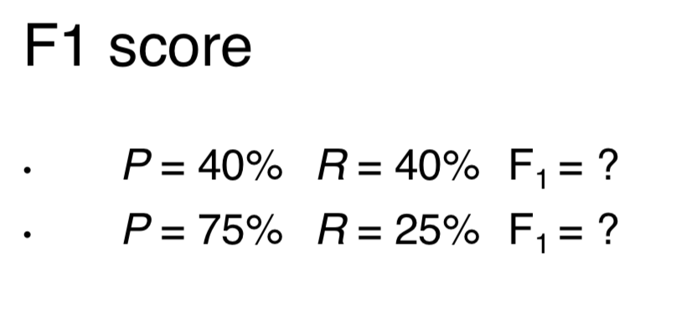
F1 Score

Slide 33
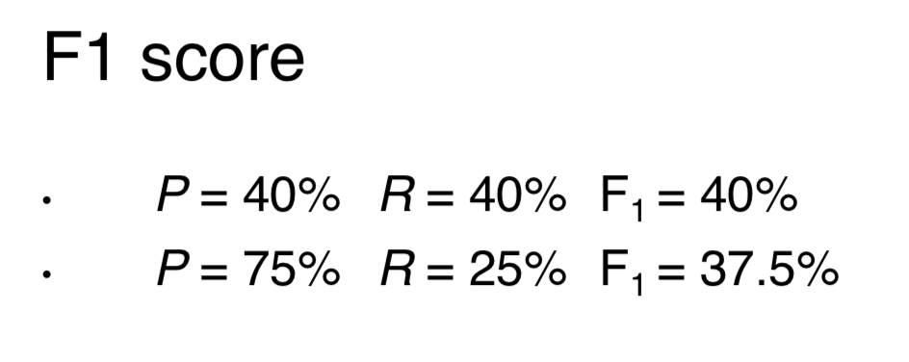
F1 Score

Slide 34
NER Evaluation Example
TRUTH:
Michael Kearns and Sebastian Seung will start Monday’s tutorial, followed by Richard M. Karpe and Martin Cooke.
PRED:
Michael Kearns and Sebastian Seung will start Monday’s tutorial, followed by Richard M. Karpe and Martin Cooke.
# correctly predicted segments 2
Precision = =
# predicted segments 6
# correctly predicted segments 2
Recall = =
# true segments 4

Slide 35
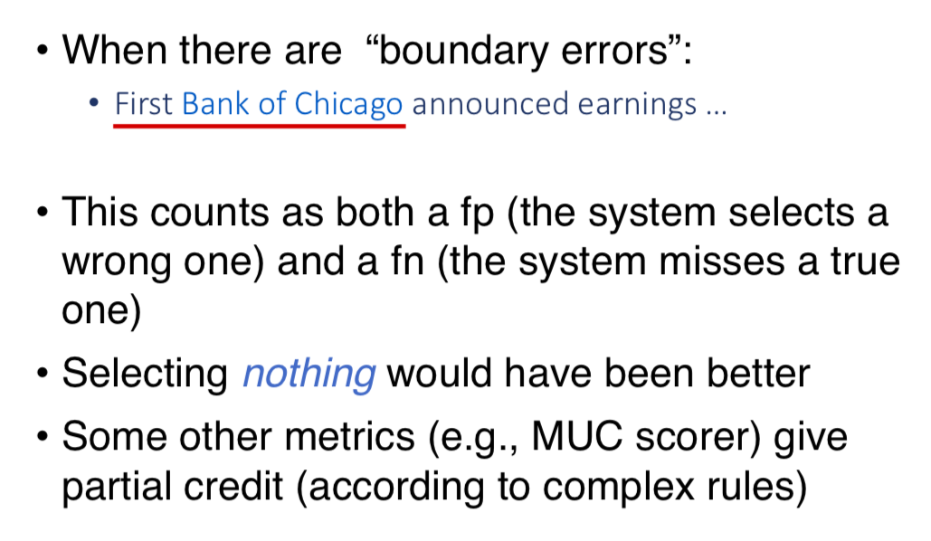
NER Evaluation Example

Slide 36
Public Benchmarks for NER
CoNLL-2002 & CoNLL-2003 (British newswire)
Multiple languages: Spanish, Dutch, English, German
4 entities: Person, Location, Organization, Misc
MUC-6 & MUC-7 (American newswire)
7 entities: Person, Location, Organization, Time, Date, Percent, Money
ACE
5 entities: Location, Organization, Person, FAC, GPE
BBN (Penn Treebank)
22 entities: Animal, Cardinal, Date, Disease, ...

Slide 37
NER Approaches
1. Rule/Pattern-Based
2. Standard Classifiers
KNN, decision tree, naïve Bayes, SVM, ...
3. Sequence Models
HMMs, CRFs, LSTM-CRF

Slide 38
Rule Based NER

Slide 39
Rule Based NER
Create regular expressions to extract:
Telephone number
E-mail
Capitalized names

Slide 40
Regular Expressions
Regular expressions provide a flexible way to match strings of text, such as particular characters, words, or patterns of characters
Suppose you are looking for a word that:
1.
2.
3.
4.
5.
starts with a capital letter “P”
is the first word on a line
the second letter is a lower case letter
is exactly three letters long
the third letter is a vowel
the regular expression would be “^P[a-z][aeiou]” where
^ - indicates the beginning of the string [a-z] – any letter in range a to z
[aeiou] – any vowel

Slide 41
Rule Based NER
Create regular expressions to extract:
Telephone number
E-mail
Capitalized names
blocks of digits separated by hyphens
RegEx = (\d+\-)+\d+

Slide 42
Rule Based NER
Create regular expressions to extract:
Telephone number
E-mail
Capitalized names
blocks of digits separated by hyphens
RegEx = (\d+\-)+\d+
matches valid phone numbers like 900-865-1125 and 725-1234
incorrectly extracts social security numbers 123-45-6789
fails to identify numbers like 800.865.1125 and (800)865-CARE
Improved RegEx = (\d{3}[-.\ ()]){1,2}[\dA-Z]{4}

Slide 43
Rule Based NER
Create rules to extract locations
Capitalized word + {city, center, river} indicates location Ex. New York city
Hudson river
Capitalized word + {street, boulevard, avenue} indicates location
Ex. Fifth avenue

Slide 44
Rule Based NER
For unstructured human-written text, some NLP may help
Part-of-speech (POS) tagging
Mark each word as a noun, verb, preposition, etc.
Syntactic parsing
Identify phrases: NP, VP, PP
Semantic word categories (e.g. from WordNet)
KILL: kill, murder, assassinate, strangle, suffocate

Slide 45
Rule Based NER
Determining which person holds what office in what organization
[person] , [office] of [org]
Vuk Draskovic, leader of the Serbian Renewal Movement
[org] (named, appointed, etc.) [person] Prep [office]
NATO appointed Wesley Clark as Commander in Chief
Determining where an organization is located
[org] in [loc]
NATO headquarters in Brussels
[org] [loc] (division, branch, headquarters, etc.)
KFOR Kosovo headquarters

Slide 46

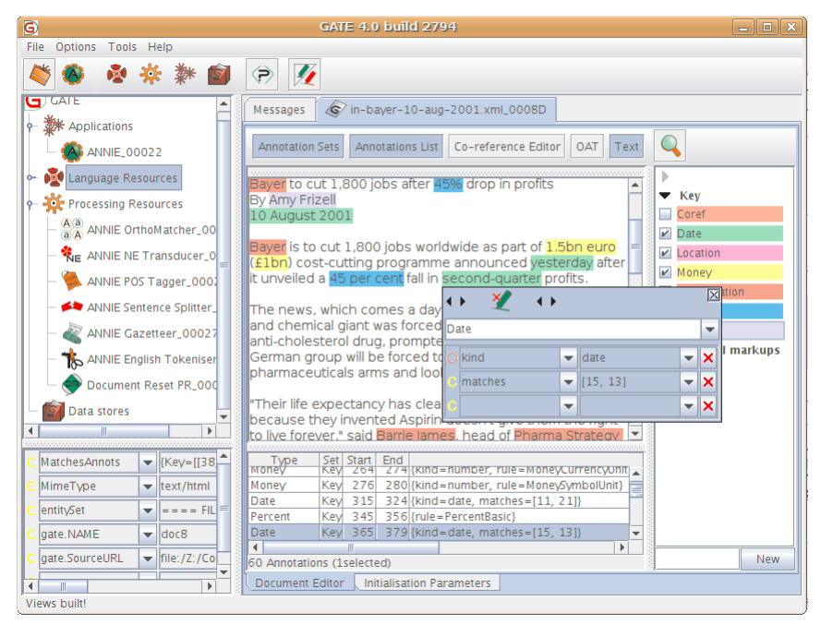
Software

Slide 47
Rules to Identify a Single Entity
An example of a pattern for identifying person names of the form “Dr. Yair Weiss” consisting of
a title token as listed in a dictionary of titles (containing entries like: “Prof”, “Dr”, “Mr”),
a dot,
two capitalized words
({DictionaryLookup = Titles} {String = “.”} {Orthography type = capitalized word}{2}) → Person Names.

Slide 48
Rules to Identify a Single Entity
An example of a rule for marking all numbers following words “by” and “in” as the Year entity is
({String=“by”|String=“in”}) ({Orthography type = Number }):y → Year=:y.

Slide 49
Rules to Identify a Single Entity
Another example for finding company names of the form “The XYZ Corp.” or “ABC Ltd.” is given by
({String=“The”}? {Orthography type = All capitalized} {Orthography type = Capitalized word, DictionaryType = Company end}) → Company name.

Slide 50
Rules to Mark Entity Boundaries
Sometimes it is more efficient to define separate rules to mark the start and end of an entity boundary.
These are fired independently and all tokens in between two start and end markers are called as the entity
An example of a rule to insert a ⟨journal⟩ tag to mark the start of a journal name in a citation record
({String=“to”} {String=“appear”} {String=“in”}):jstart ({Orthography type = Capitalized word}{2-5}) → insert ⟨journal⟩ after:jstart.

Slide 51
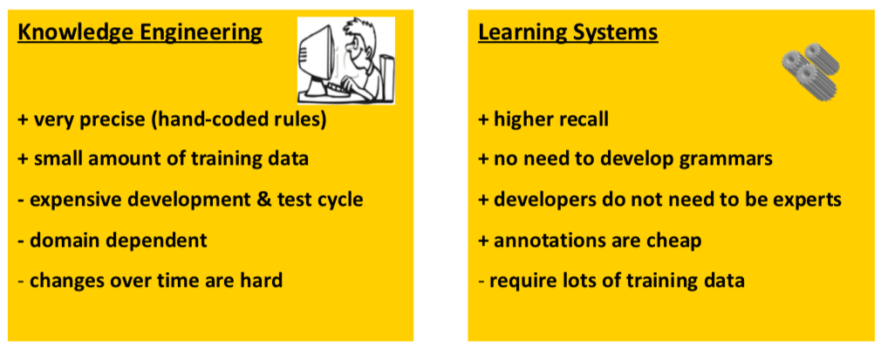
Knowledge Engineering vs. Machine Learning

Slide 52
Standard Classifiers for NER

Slide 53
Workflow of Token-wise Classifiers
Training
Collect a set of representative training documents
Label each token for its entity class or other (O)
Design feature extractors appropriate to the text and classes
Train a classifier to predict the labels of each token in the annotated training sentences
Testing
Receive a set of testing documents
Run trained classifier to label each token
Appropriately output the recognized entities

Slide 54
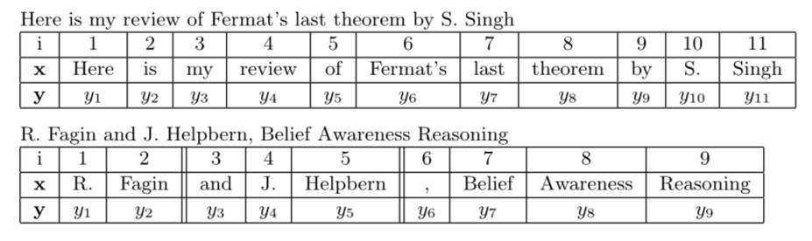
Token-Level Input/Label
Input: X = a sequence of tokens
Label: Y = a sequence of labels e.g.
Y ={HouseNo, Street, City, State, Zip, Country, Other}.
Multi-token
Entity labeling
Schemas
BCEO (B=Begin, C=Continue, E=End, O=Other)
BIO (B=Begin, I=Inside, O=Other)

Slide 55
Encoding labels for sequence
IO labeling schema:
The O
European ORG
Commission ORG
said O
on O
Thursday O
it O
disagreed O
with O
German MISC
Part of ORG entity
Part of ORG entity
Part of MISC entity

Slide 56
Encoding labels for sequence
BIOES labeling schema:
The O
European B-ORG
Commission E-ORG
said O
on O
Thursday O
it O
disagreed O
with O
German S-MISC
Begin of Entity
End of Entity
Singleton Entity

Slide 57
Encoding labels for sequence
BIO / BIOES labeling schema:
The O
European B-ORG
Commission E-ORG
said O
on O
Thursday O
it O
disagreed O
with O
German S-MISC
The
European Commission said
on
Thursday
it disagreed with German

Slide 58
NER as a Classification Problem
NED: Identify named entities using BIO tags
B beginning of an entity
I continues the entity
O word outside the entity
NEC: Classify into a predefined set of categories
Person names
Organizations (companies, governmental organizations, etc.)
Locations (cities, countries, etc.)
Miscellaneous (movie titles, sport events, etc.)

Slide 59
Features for NER
Words
Current word (essentially like a learned dictionary)
Previous/next word (context)
Orthographic
E.g., Capitalizations, presence of dot
Other kinds of inferred linguistic classification
Part-of-speech tags
Label context
Previous (and perhaps next) label

Slide 60
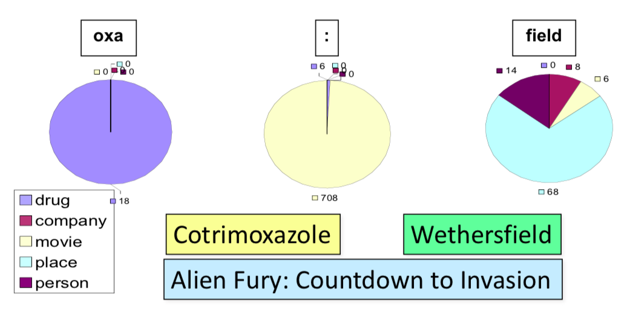
Features: Word Substrings

Slide 61
Features for NER
Word Shapes (Orthographic)
Map words to simplified representation that encodes attributes such as length, capitalization, numerals, Greek letters, internal punctuation, etc.
Varicella-zoster | Xx-xxx
mRNA | xXXX
CPA1 | XXXd

Slide 62
Classical Learning Models on NER
KNN
Decision Tree
Naïve Bayes
SVM
…
Boosting, …

